Slide 1
MINOR MID EVALUATION
CRICKET SHOT COMMENTARY
Vibhuti Narayan -1780
Puneet Jain - 1780
Shubham Singh- 17103088
Varun Singhai - 17103068

Slide 2
PROBLEM STATEMENT
How can we generate Automatic Cricket Commentary ?
Our objective is to try and build a dynamic model wherein it provides commentary of the cricket shots played in match.
Automating the commentary system
Providing commentary on real time basis
Issues
This is a hard problem to tackle, because of visual feature extraction.
It involves very complex temporal dynamics and handling of long term dependencies
Commentary is generally highly contextualized by the development of current game

Slide 3
STRATEGIES
At first we implemented CNN on small data sets(of images only) to try and figure out the accuracy we can achieve through it.
It took a lot of time in trying to train datasets(even small of 200 sets)
And the accuracy was around 15-20%
As the results were unconvincing and we wanted a more dynamic based implementation we switched to classification implementation of it in ML.
Have 6 classes of shots -> cover,cut,leg,pull,scoop,straight
As it was more feasible than Deep Learning.
And so far thus we have been trying to build a suitable model to get us more
accuracy.

Slide 4
RESEARCH PAPERS REFERRED
Shot-Net: A Convolutional Neural Network for Classifying Different Cricket Shots.
cricket shot classification approach by CNNmodel having 13 layers
https://github.com/shakirul15-311/Shot-Net
Cricket shot detection from videos
The model relies on optical flow to bring out static
and dynamic cues and on Deep Convolutional Neural Networks
(DCNN) for extracting representations.
https://ieeexplore.ieee.org/document/8494081

Slide 5
Data Sets
We have gathered images from one of the research papers approx 2500
After gathering , images ere fed on posenet to get 17 features from it
PoseNet, an open source human pose estimation model, provides the building blocks necessary for real time human pose detection. PoseNet provides confidence scores for detection of key human body parts such as joints and facial features within an image
Discrepancies in data as for example negative score for some parts were corrected , missing data cases were evaluated before training .
Data splicing was done in a ratio of 8:2 ,80% for training and 20 for testing

Slide 6
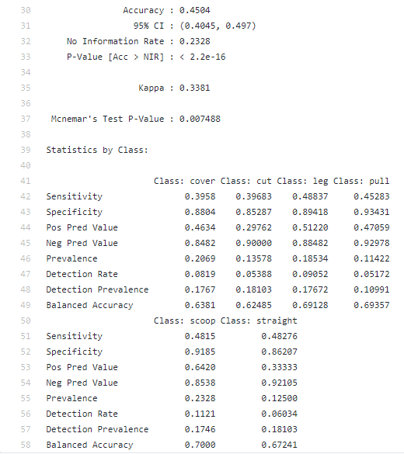
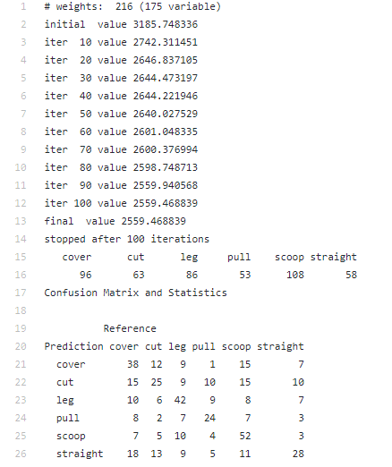
Logistic Regression

Slide 7
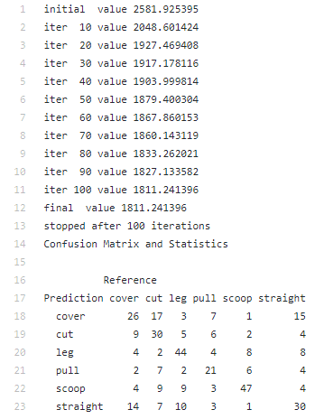
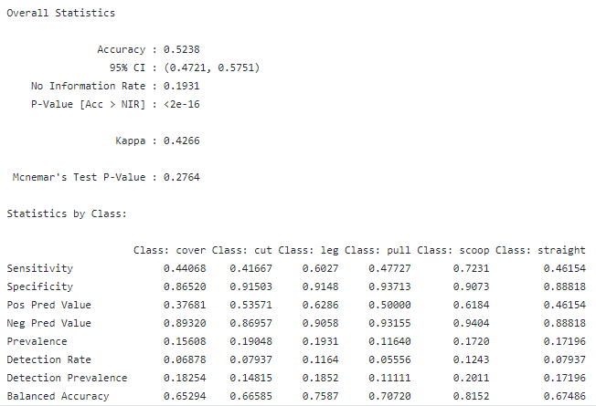
Logistic Regression
removing negative and updating features

Slide 8
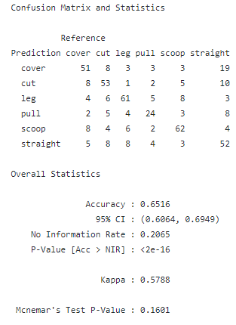
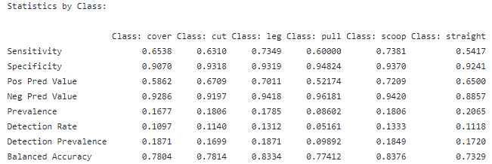
Gradient Boosting

Slide 9
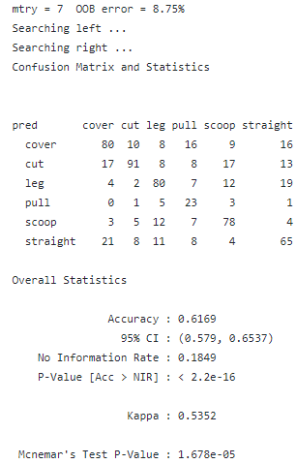
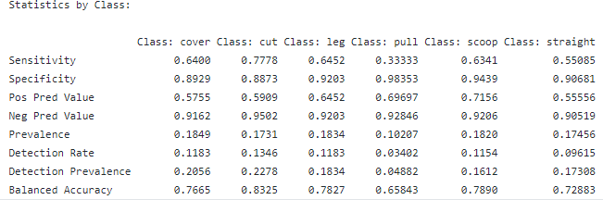
Random Forest

Slide 10
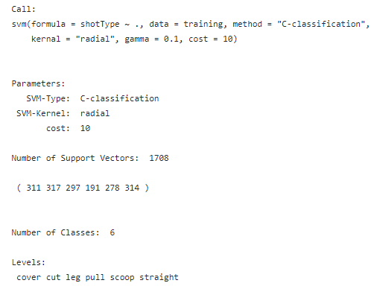
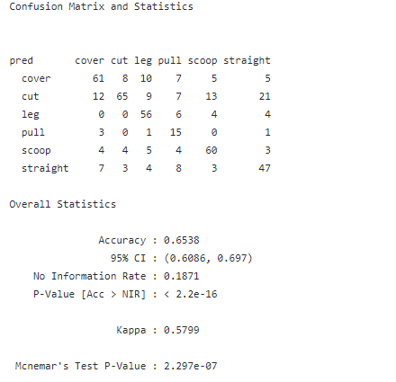
Support Vector Machine

Slide 11
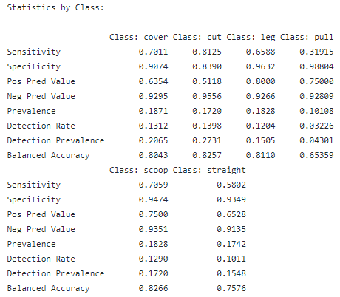
SVM continued

